Slide 1

INTRODUCTION
SQL CASE STUDY

Slide 2
PROJECT OVERVIEW
Project
SQL CASE STUDY
Description—This is the data from stores chain with multiple locations
Conducted By
Narayan Singh(Nikhil)
Data Source
Learnbay

Slide 3

DATA SET
No. Of Tables
Table Names- Stores- 50 rows,
Sales- 8 lakh+ rows
Products- 36 rows
Inventory- 1539 rows
Customers
Products
Categories

Slide 4
TOOLS
SQL, Tableau
Data Visualization & Dynamic Dashboard
MS Power Point
Presentation and Insights

Slide 5


INSIGHTS

Slide 6
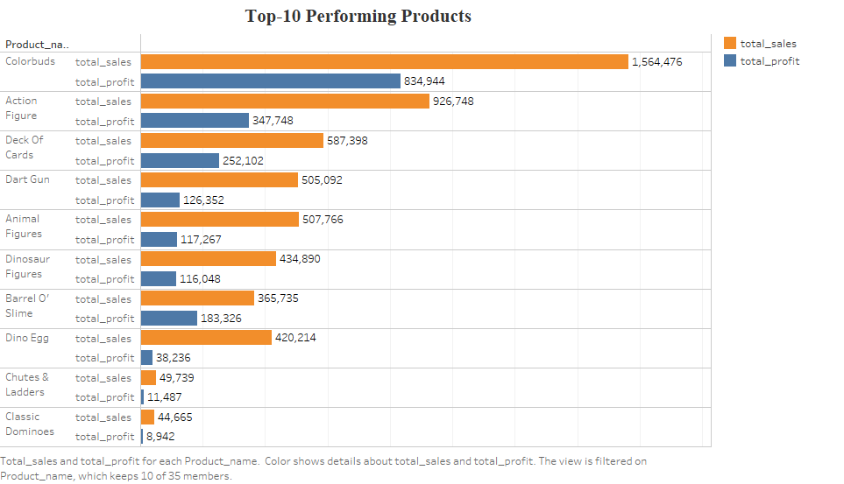

Slide 7
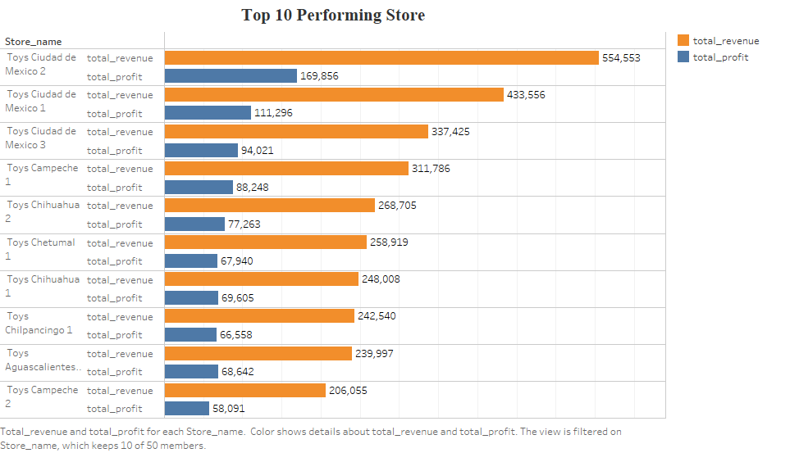

Slide 8
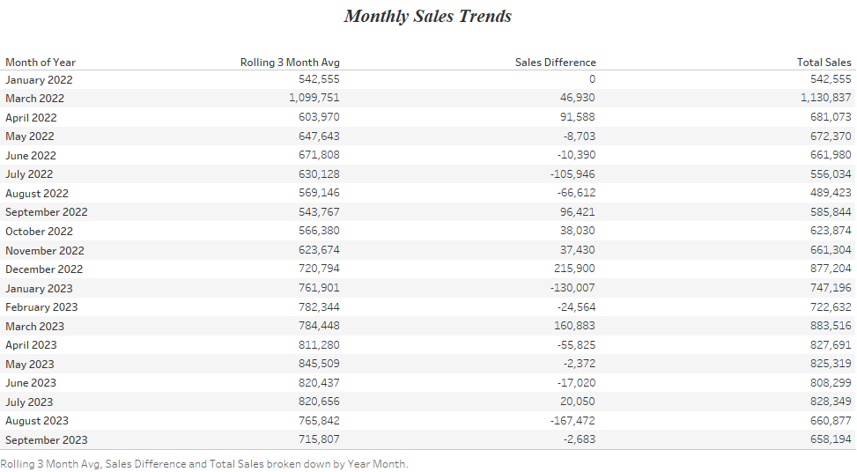

Slide 9
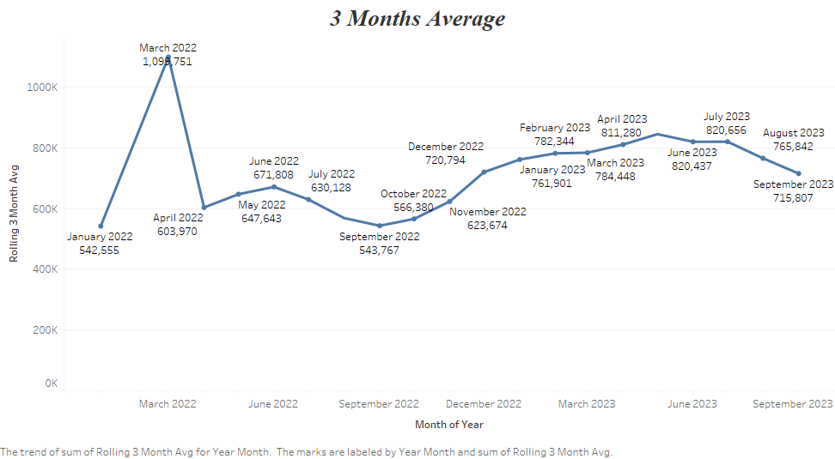

Slide 10
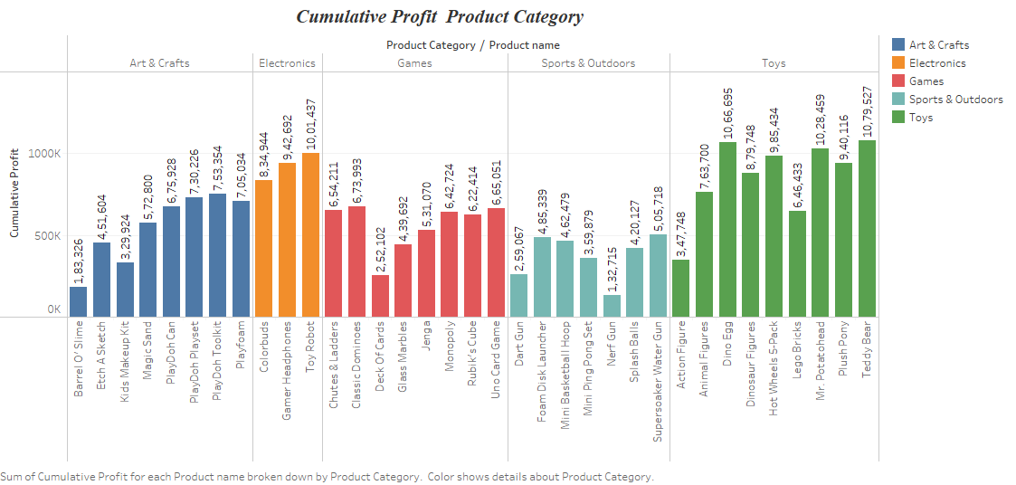

Slide 11
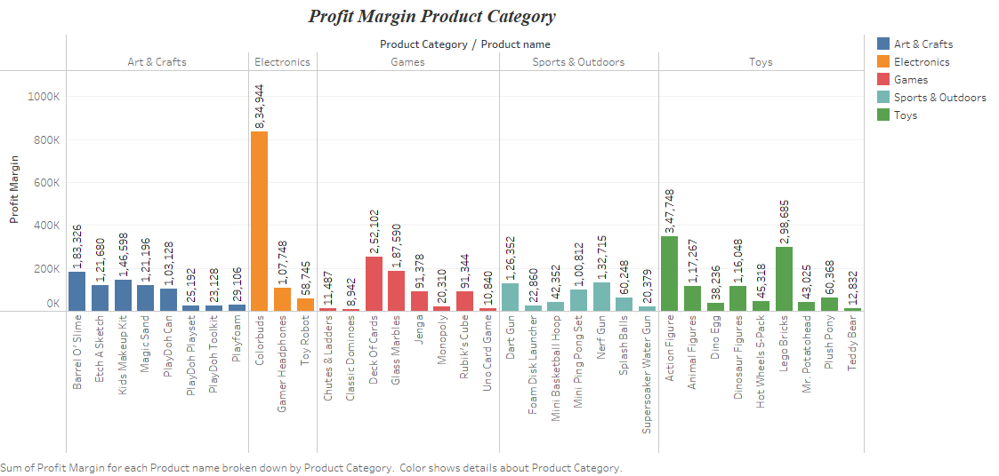

Slide 12
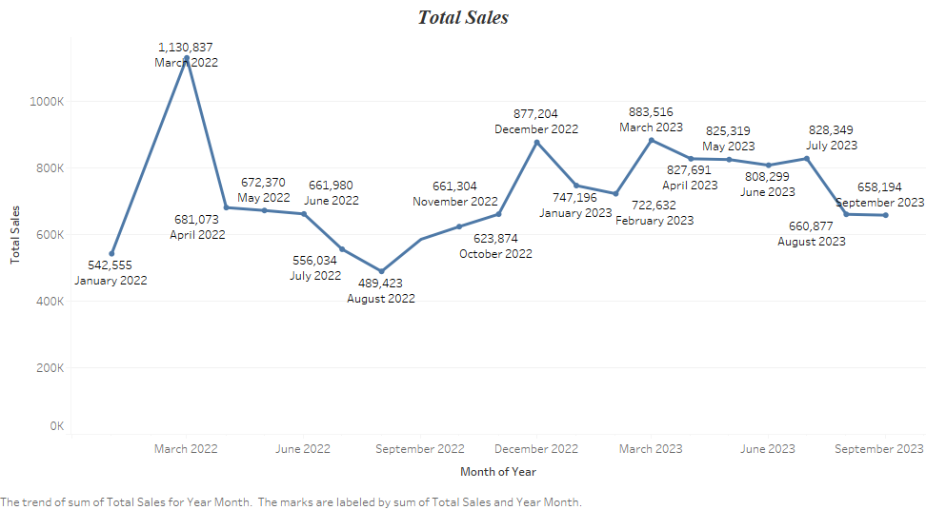

Slide 13

THANK YOU

